Slide 1
How Do I Grow Mature as a Believer in Jesus Christ?
Preached by Dr. Jim Harmeling at Crossroads International Church Singapore • CICFamily.com Uploaded by Dr. Rick Griffith • Singapore Bible College Files in many languages for free download at BibleStudyDownloads.org

Slide 2
1 Corinthians 3:1-2
¹ But I, brothers, could not address you as spiritual people, but as people of the flesh, as infants in Christ. ² I fed you with milk, not solid food, for you were not ready for it. And even now you are not yet ready.

Slide 3
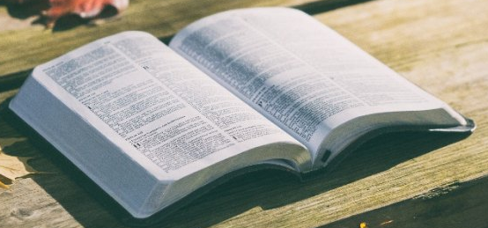
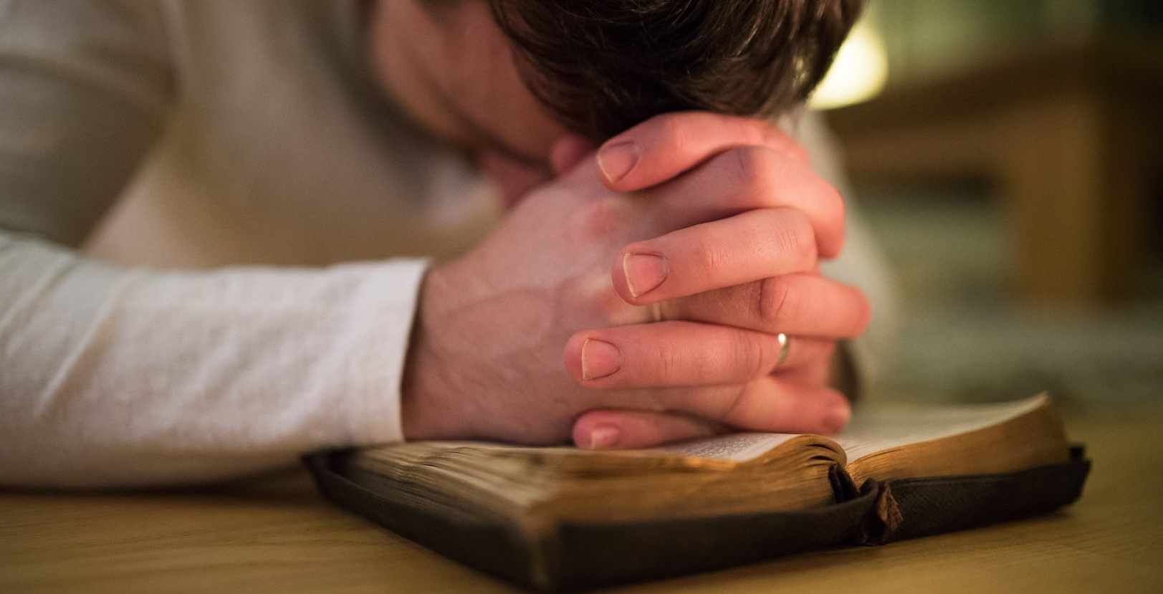
Primary Means of Spiritual Growth
Bible
Prayer

Slide 4
Ask the root question
How do I glorify God with my life?

Slide 5
Romans 11:36
For from him and through him and to him are all things. To him be glory forever. Amen.
Ephesians 3:21
to him be glory in the church and in Christ Jesus throughout all generations, forever and ever. Amen.
1 Corinthians 10:31
So, whether you eat or drink, or whatever you do, do all to the glory of God.

Slide 6
Psalm 115:1
Not to us, O Lord, not to us,
but to your name give glory, for the sake of your steadfast love and your faithfulness!

Slide 7
Grow in the knowledge and application of God’s Word
John 17:17
Sanctify them in the truth; your word is truth

Slide 8
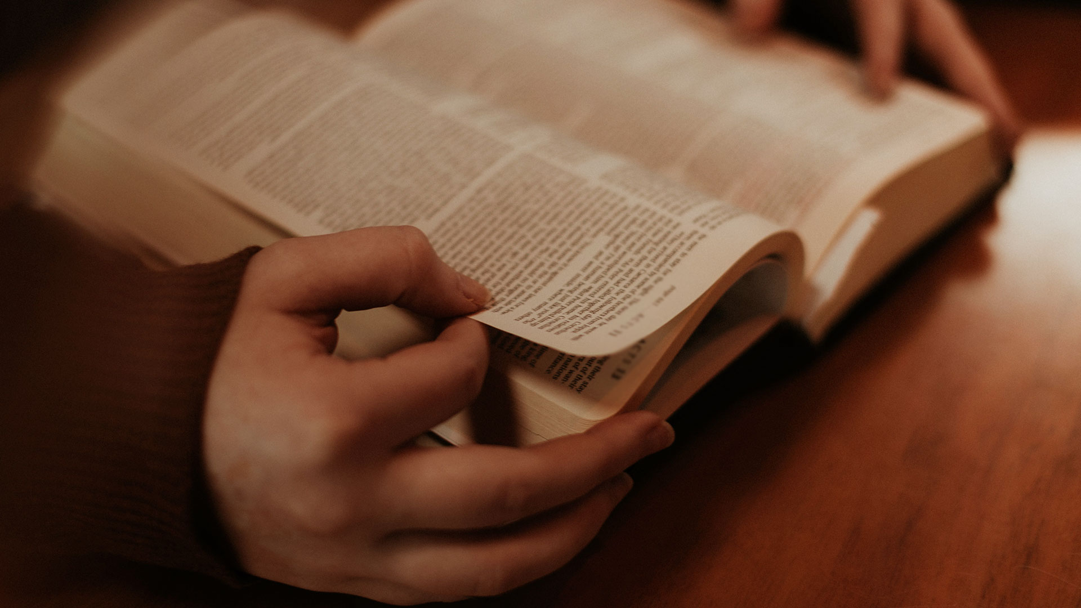
Why should I learn the Bible?
It is inspired

Slide 9
2 Peter 1:20-21
²⁰ knowing this first of all, that no prophecy of Scripture comes from someone's own interpretation. ²¹ For no prophecy was ever produced by the will of man, but men spoke from God as they were carried along by the Holy Spirit.

Slide 10
Why should I learn the Bible?
It is inspired
It is without error

Slide 11
Psalm 19:7-8
⁷ The law of the Lord is perfect, reviving the soul; the testimony of the Lord is sure, making wise the simple; ⁸ the precepts of the Lord are right, rejoicing the heart; the commandment of the Lord is pure, enlightening the eyes.

Slide 12
Why should I learn the Bible?
It is inspired
It is without error
It is authoritative

Slide 13
Titus 2:15
Declare these things; exhort and rebuke with all authority. Let no one disregard you.

Slide 14
Why should I learn the Bible?
It is clear
It is inspired
It is without error
It is authoritative

Slide 15
Psalm 119:105
Your word is a lamp to my feet and a light to my path.

Slide 16
Why should I learn the Bible?
It is clear
It is inspired
It is without error
It is sufficient
It is authoritative

Slide 17
2 Peter 1:3
His divine power has granted to us all things that pertain to life and godliness, through the knowledge of him who called us to his own glory and excellence.

Slide 18
Why should I learn the Bible?
It is clear
It is inspired
It is without error
It is sufficient
It is authoritative
It is relevant

Slide 19
1 Peter 1:23-25
²³ since you have been born again, not of perishable seed but of imperishable, through the living and abiding word of God; ²⁴ for
“All flesh is like grass and all its glory like the flower of grass. The grass withers, and the flower falls, ²⁵ but the word of the Lord remains forever.”
And this word is the good news that was preached to you.

Slide 20
Hebrews 4:12
For the word of God is living and active, sharper than any two-edged sword, piercing to the division of soul and of spirit, of joints and of marrow, and discerning the thoughts and intentions of the heart.

Slide 21
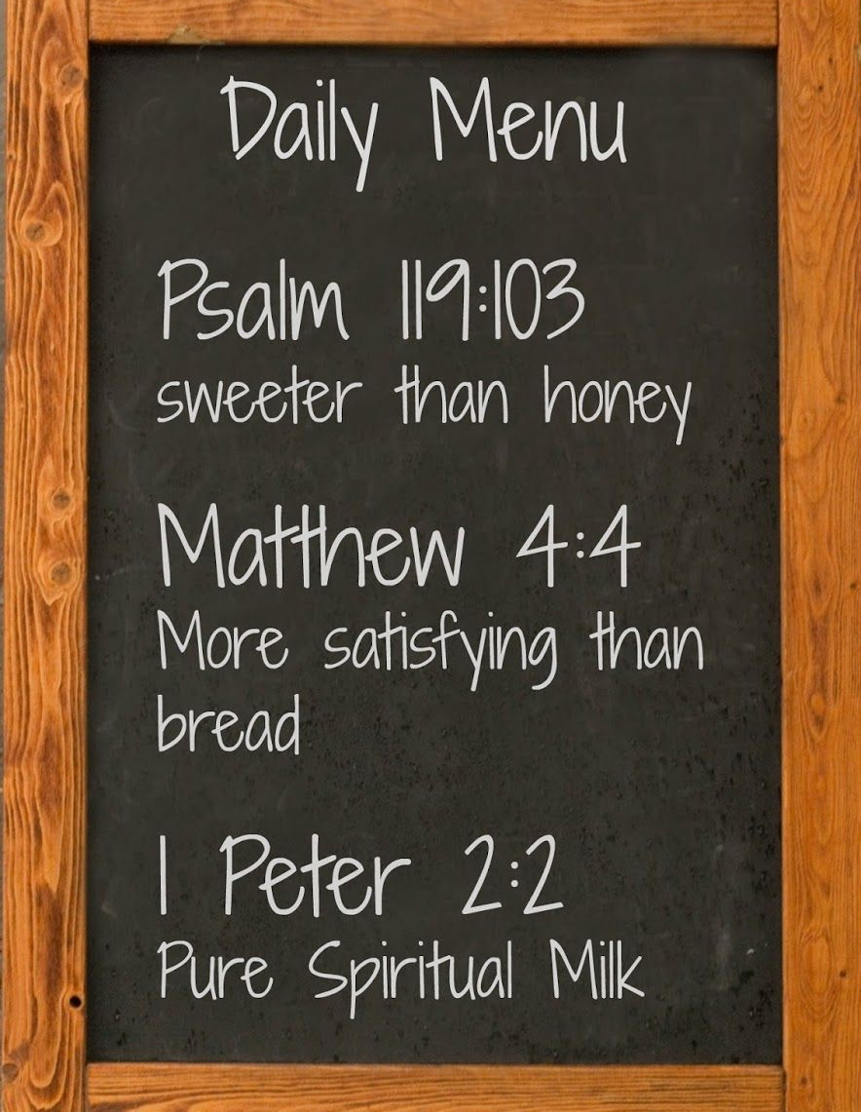
How can I learn the Bible?
Hear the Bible
-ESV Bible app
-Teaching podcasts
(John MacArthur; John Piper; Alister Begg; R.C. Sproul; David Jeremiah; Greg Laurie; Chuck Swindoll)

Slide 22
How can I learn the Bible?
Hear the Bible
Read the Bible
Study the Bible
BibleStudyDownloads.org

Slide 23
How can I learn the Bible?
Hear the Bible
Read the Bible
Study the Bible
Meditate on the Bible

Slide 24
How can I learn the Bible?
Joshua 1:8
This Book of the Law shall not depart from your mouth, but you shall meditate on it day and night, so that you may be careful to do according to all that is written in it. For then you will make your way prosperous, and then you will have good success.

Slide 25
How can I learn the Bible?
Hear the Bible
Read the Bible
Study the Bible
Meditate on the Bible
Memorize the Bible

Slide 26
How can I learn the Bible?
Psalm 119:11
I have stored up your word in my heart, that I might not sin against you.
VerseLocker app
Biblememory.com

Slide 28
Black

Slide 29
Topical Preaching link at BibleStudyDownloads.org
Get this presentation for free!
Notes:
The Bible…Basically (bb)

